Slide 1
Python – Features and Applications
Premanand S

Slide 2
Why ?
Easy
Interpreted
Free and Open source
Portable (OS)
Large Python Library
GUI Programming
Extensible
Expressive
Increased Productivity
Huge Community
High Level Language
Integrated Language
Interpreted Language
Dynamic

Slide 3
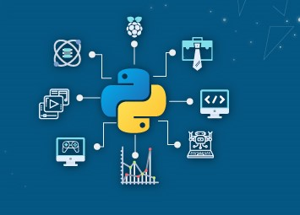
Application

Slide 4

Build website
Django, Pyramid, Flask

Slide 5
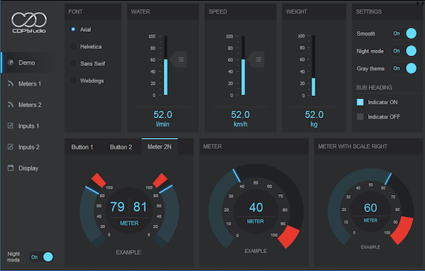
Desktop GUI application
Kivy, PyQT, and Tkinter

Slide 6

Gaming & 3D Graphics
Pygame, PyopenGL, Pyglet, Panda3D

Slide 7
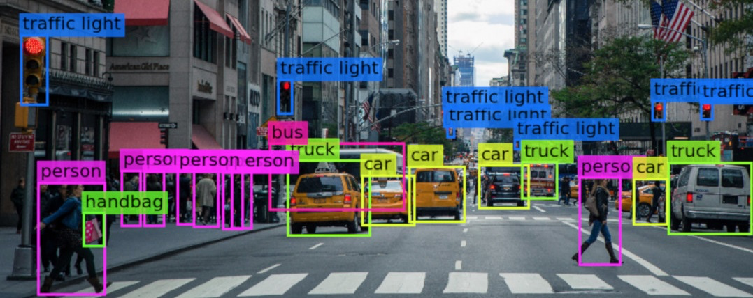
Computer Vision
Fastai, Ipsdk, Imutils, Keras
Opencv, Pytessarct, PyTorchCV
Scikit-Image, SimpleCV

Slide 8
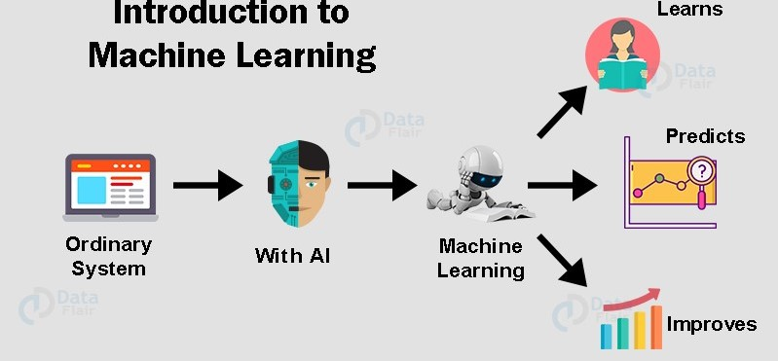
Machine Learning
Numpy, Scipy, Scikit-learn, Pandas, Matplotlib
Theano, TensorFlow, Keras, PyTorch

Slide 9
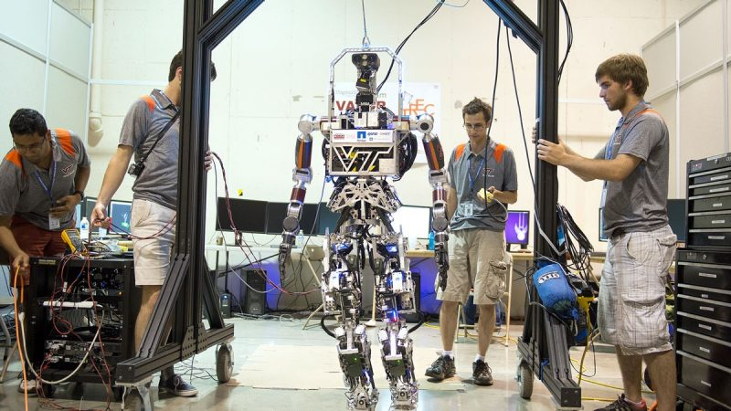
Robotics
Robot Framework, Pyro, DART, PyRobot
PyDy, Klamp’t, Pybotics

Slide 10
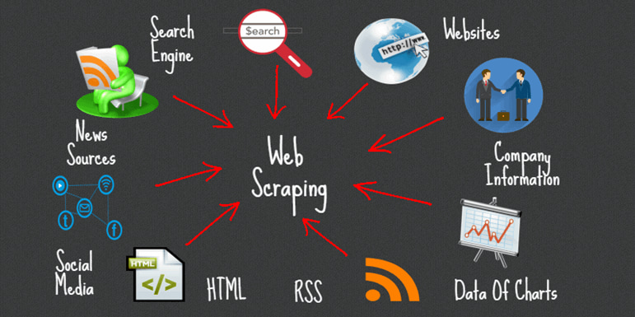
Web Scarping
Requests, lxml, Beautiful Soup, Selenium, Scrapy

Slide 11

Data Analysis
Numpy, Pandas, Matplotlib, Scikit-learn, Statsmodels
Seaborn,

Slide 12
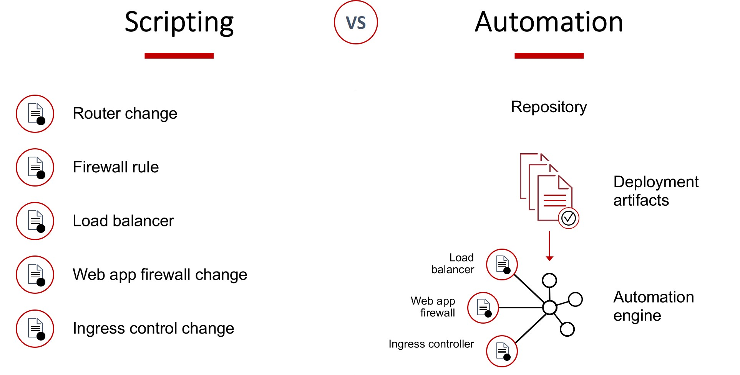
Automate Scripting
PyAutoGUI, Pywinauto

Slide 13
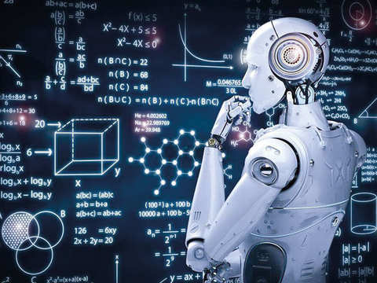
Artificial Intelligence
TensorFlow, NLTK, FANN

Slide 14
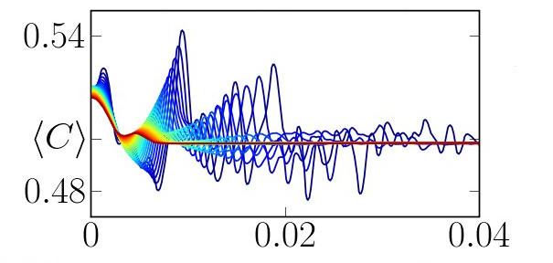
Scientific Computing
SciPy, Pandas, NL toolkit, Astropy, BioPython, Dask
Deap, Dmelt, Nilearn

Slide 15
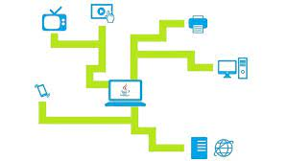
Network Programming
Gopherlib, urllib, telnetlib, impalib, mntplib

Slide 16
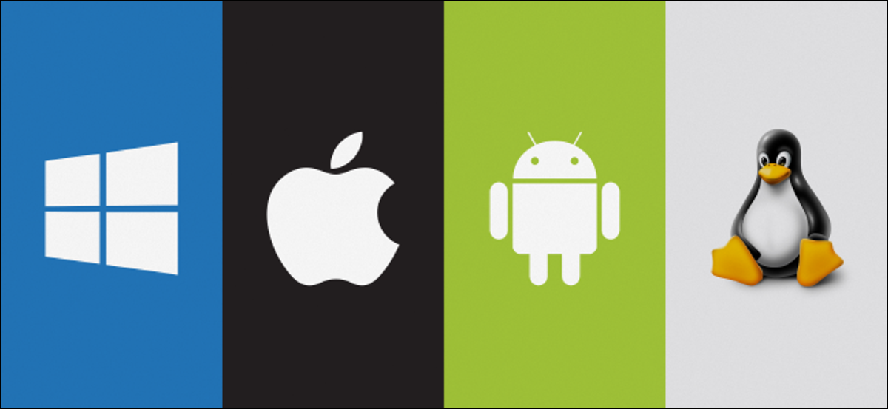
OS

